Slide 1
Advances in Bioinformatics: Multi-Omics Integration
Session 1: Foundations for Understanding Multi-Omics Research BCB-SR Bioinformatics & Computational Biology Journal Club

Slide 2
Welcome to the Multi-Omics Integration Series!
This intro session will cover:
What each omics layer measures and why it matters
Study design frameworks: parallel vs joint profiling
Analysis insights: sample-focused vs feature-focused
Key challenges facing the field
Goal: Prepare to critically engage with upcoming journal club sessions

Slide 3
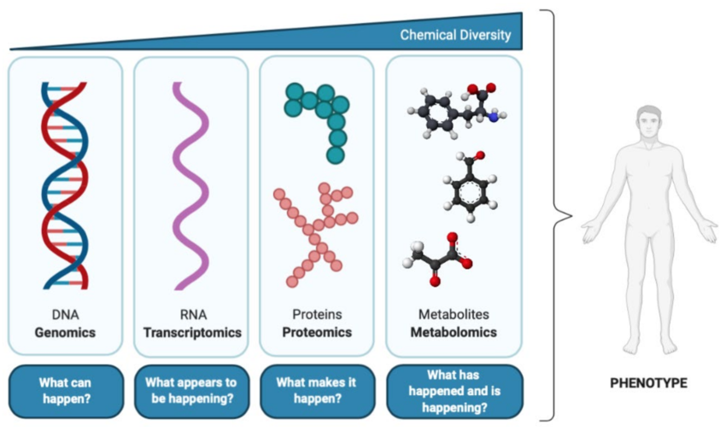
The Multi-Layered Biology of Cells
Genome→Epigenome→Transcriptome→Proteome→ Metabolome
Each layer captures different biological information
Regulation flows across layers
Feedback loops create complexity
Notes:
Each layer represents a different level of biological organization. Regulation flows across layers but is not strictly linear - feedback loops and post-transcriptional control create complex layer-to-layer relationships. Single-layer measurements answer “what is present?” Multi-omics answers “what is active, regulated, and functional?”
Figure source: Ramirez et al., Metabolites, 2013

Slide 4
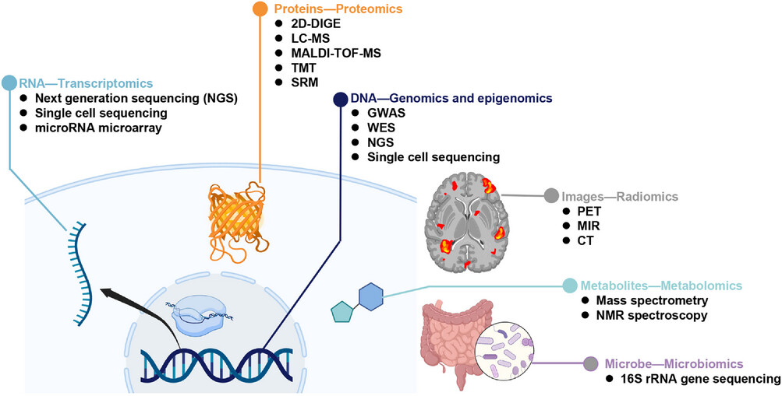
What Is Multi-Omics Integration?
Multi-omics integration combines measurements from multiple molecular layers to:
Reveal regulatory relationships
Uncover disease mechanisms
Classify molecular subtypes
Predict clinical outcomes
Notes:
Each omics layer captures one view of a connected biological system. Integration attempts to recover relationships between layers to understand how regulation flows from genome through proteome to phenotype. Integration serves two major purposes: mechanistic understanding (feature-focused) and patient classification (sample-focused).
Figure source: Wu et al., MedComm, 2023

Slide 5
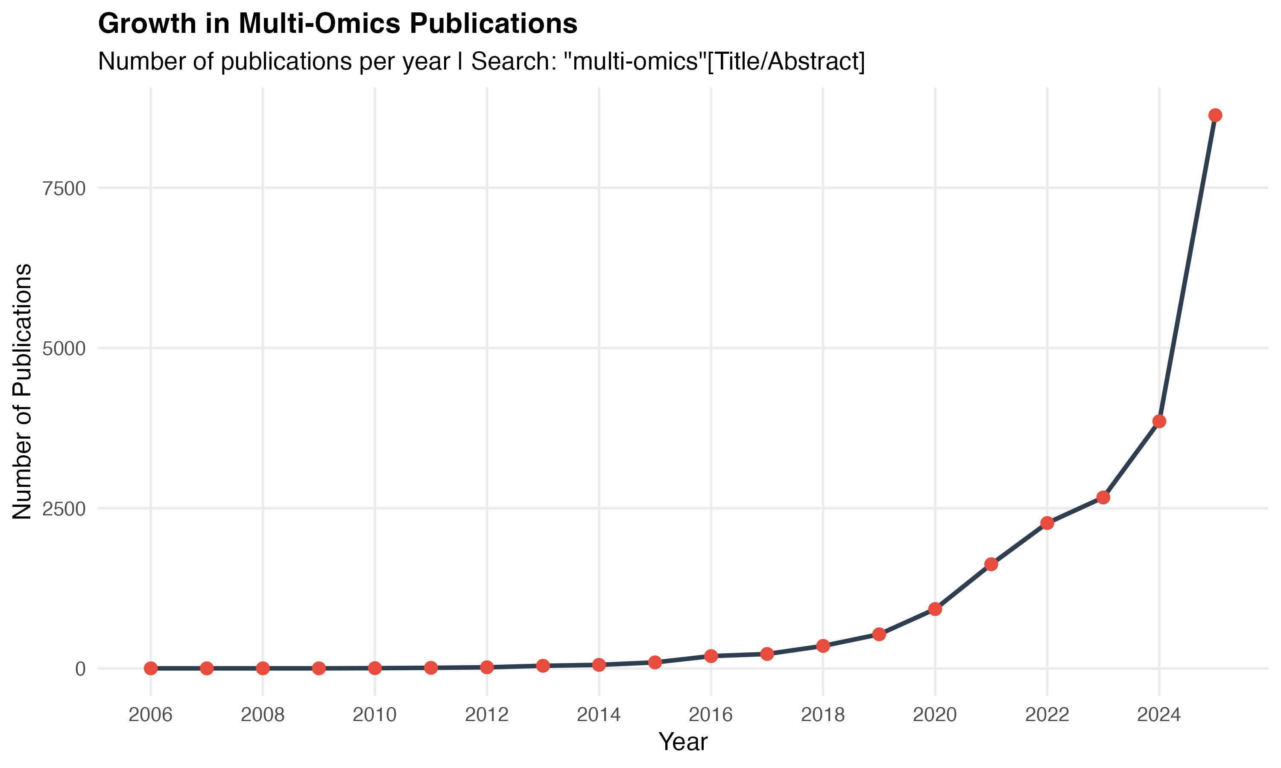
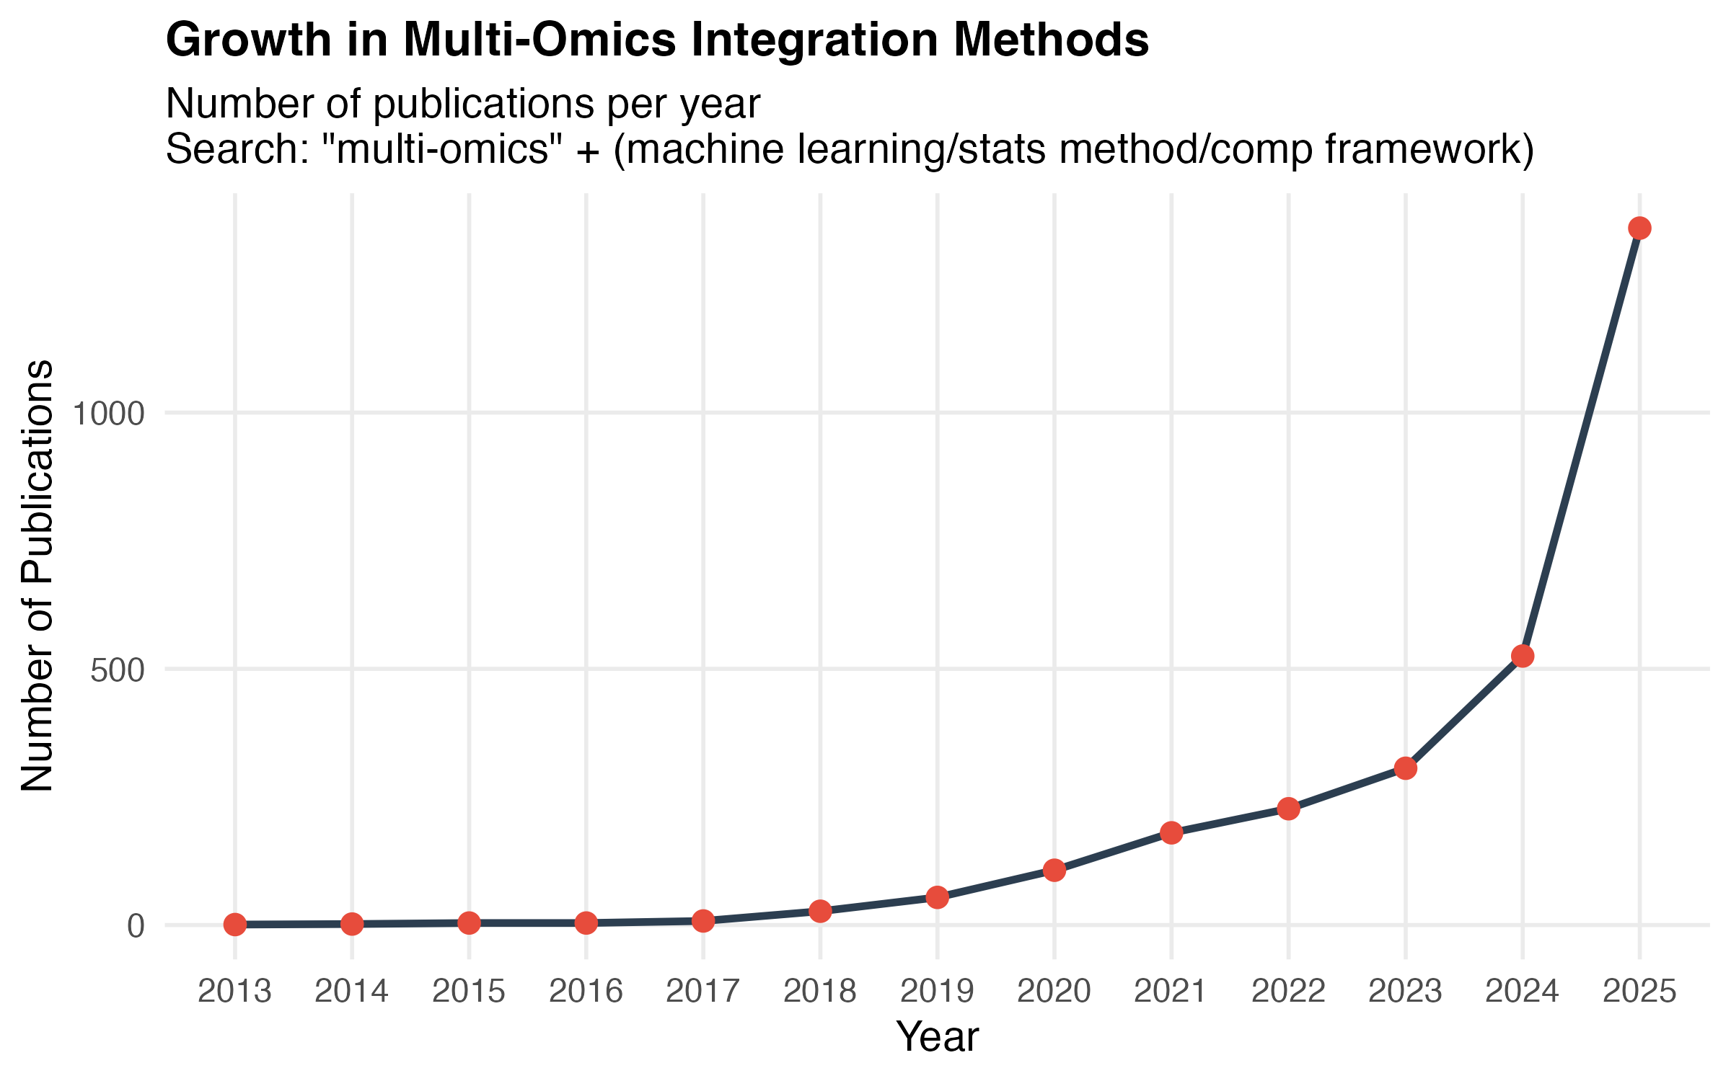
Why we’re talking about Multi-Omics Integration now
Rapid growth in development of methods for multi-omics analysis
Notes:
TCGA Timeline:
2006: TCGA pilot project starts
2009-2010: TCGA becomes full program, data collection ramps up
2011-2013: Early cancer-type specific papers published
2013-2016: Major individual cancer papers with multi-omics integration (breast, ovarian, lung, etc.)
2018: Pan-Cancer Atlas - 27 major papers in Nature/Cell (THE watershed moment)
2016-2018: TCGA ends data collection, shifts to analysis phase
Did TCGA catalyze multi-omics methods? YES!
Look at your data:
2013-2017: Slow growth (1→8 methods papers) - TCGA data becoming available
2018-2020: Acceleration (27→107) - Pan-Cancer Atlas published in 2018
2020-2025: Explosion (107→1360) - TCGA fully mature + other factors
Other catalysts converging:
Single-cell multi-omics tech maturation:
CITE-seq: 2017
10X Multiome: ~2021
ML/AI boom:
Deep learning for genomics: 2015+
AlphaFold: 2020
ChatGPT/LLMs: 2022-2023
COVID pandemic (2020-2021):
Remote computational work
Massive bioinformatics funding
Bottom line: TCGA (especially 2018 Pan-Cancer Atlas) created the "proof of concept" and benchmark datasets that enabled methods development explosion. It's a classic "infrastructure → innovation"

Slide 6
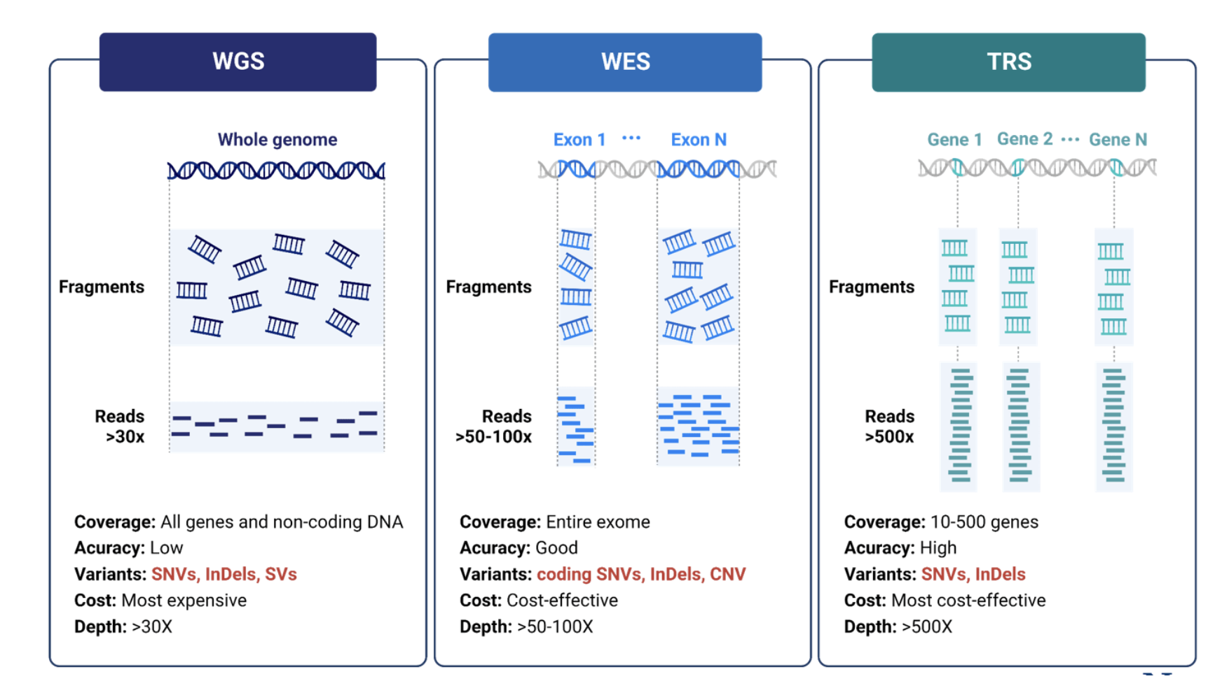
Genomics: “What can happen”
What it measures: DNA sequence variation (SNVs, indels, CNVs, structural variants)
Common technologies:
Whole-genome sequencing (WGS)
Whole-exome sequencing (WES)
Targeted panels
https://www.novogene.com/us-en/resources/blog/a-beginners-guide-to-dna-sequencing-blog/
Notes:
Genomics captures germline and somatic mutations, copy number alterations, and structural rearrangements. This is the “blueprint” layer. Study design showing DNA extraction from fresh vs FFPE samples, multiple library prep protocols, and sequencing platforms.
Figure source: Xu et al., Scientific Data, 2021

Slide 7
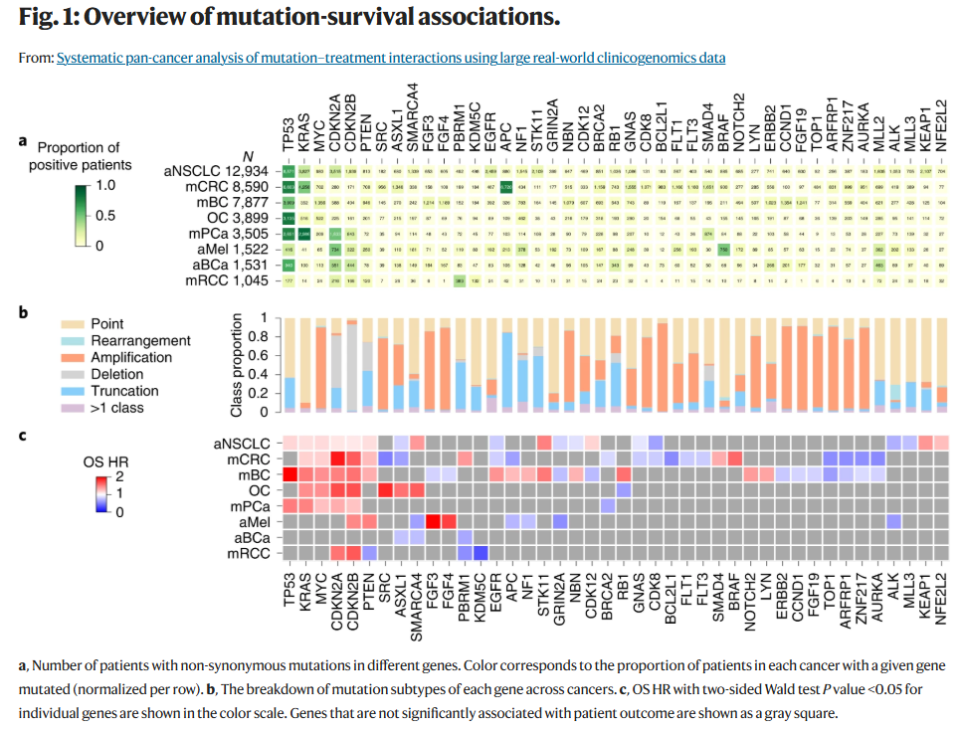
Genomics: Mapping Drivers Across Cancers
What genomics tells us: cancer susceptibility, clonal evolution, targetable alterations.
What it doesn’t tell us: whether mutated pathways are transcriptionally active, whether proteins are expressed, or how the regulatory environment shapes phenotype.
Notes:
TCGA pan-cancer mutation landscape showing recurrent driver mutations across cancer types. Panel a: Number of patients with mutations in different genes, colored by proportion of patients in each cancer type. Panel b: Breakdown of mutation types (point mutations, amplifications, etc.). Panel c: Hazard ratios for overall survival associated with individual gene mutations.
Key insight: Genomics identifies recurrent driver alterations and reveals mutation mechanisms. What genomics tells us: cancer susceptibility, clonal evolution, targetable alterations. What it doesn’t tell us: whether mutated pathways are transcriptionally active, whether proteins are expressed, or how the regulatory environment shapes phenotype.
Takeaway: Genomics defines potential—integration with other layers reveals realized biology.
Figure source: Brown et al., Nature Medicine, 2022

Slide 8
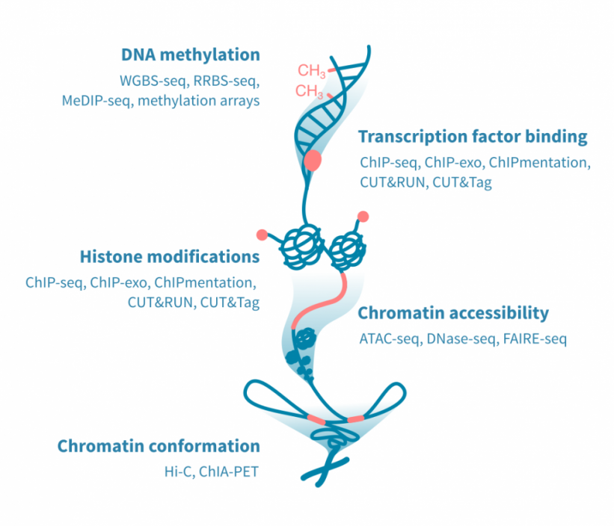
Epigenomics: ”What is poised to happen”
What it measures: Chromatin state and DNA modifications controlling gene accessibility
Common technologies:
ATAC-seq (chromatin accessibility)
ChIP-seq / CUT&RUN (TF binding, histone marks)
Bisulfite sequencing (DNA methylation)
Notes:
Epigenomics captures regulatory potential without altering DNA sequence. This layer determines which genes can be expressed. Figure shows DNA methylation assays, TF binding and histone modification assays, chromatin accessibility methods, and chromatin conformation techniques.
Figure source: Genevia Technologies (website figure)

Slide 9
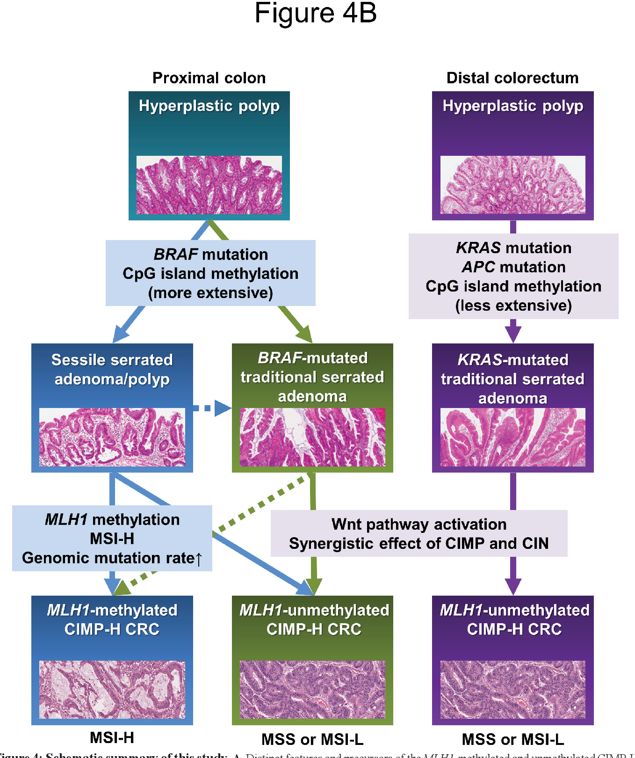
Epigenomics: Methylation-Driven Cancer Subtypes
CpG island methylator phenotype (CIMP) in colorectal cancer.
DNA methylation at CpG islands can silence tumor suppressors independently of mutation, defining distinct molecular and clinical subtypes.
What epigenomics tells us: which genes are poised for expression vs silenced, cell identity and lineage commitment, regulatory mechanisms underlying phenotype.
Notes:
CpG island methylator phenotype (CIMP) in colorectal cancer. Panel A: Distinct features of MLH1-methylated vs unmethylated CIMP-high CRCs, showing different precursor lesions (SSA/P vs TSA), mutation profiles (BRAF vs KRAS), and MMR status. Key insight: DNA methylation at CpG islands can silence tumor suppressors independently of mutation, defining distinct molecular and clinical subtypes. What epigenomics tells us: which genes are poised for expression vs silenced, cell identity and lineage commitment, regulatory mechanisms underlying phenotype.
What the Figure Shows:
Genomic data:
BRAF, KRAS, APC mutations
MLH1 genomic mutation rate
Resulting microsatellite instability status (MSI-H vs MSS/MSI-L)
Epigenomic data:
CpG island methylation extent (more vs less extensive)
MLH1 promoter methylation
CIMP (CpG Island Methylator Phenotype) status
Key Insights About Why Epigenomics Matters:
1. Different routes to the same functional outcome:
MLH1 loss-of-function can occur through either methylation (left pathway) or genomic mutation (noted in blue pathway)
Both result in mismatch repair deficiency, but through different mechanisms
2. Context-dependent molecular profiles:
Proximal colon: BRAF mutations pair with extensive methylation
Distal colon: KRAS/APC mutations pair with less extensive methylation
The combination of genetic and epigenetic changes defines tumor subtypes
3. Clinical implications:
MLH1 methylation (epigenetic) in sporadic cancer vs MLH1 mutation (genetic) in Lynch syndrome have different inheritance patterns and treatment responses
CIMP status affects prognosis and may influence therapy selection
Figure source: Yagi et al., Modern Pathology, 2012

Slide 10
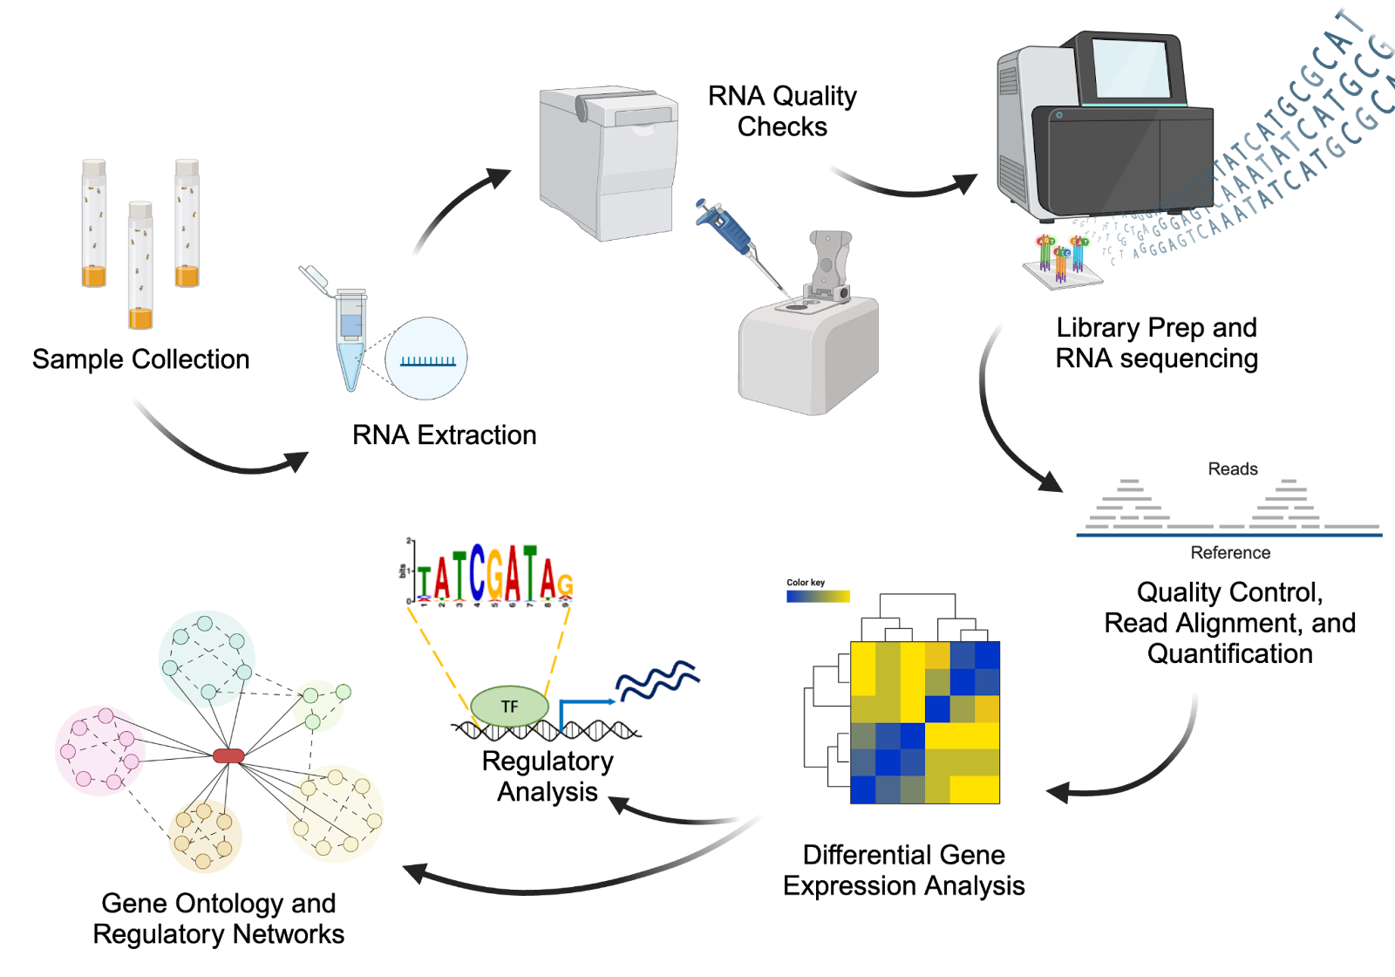
Transcriptomics: ”What appears to be happening”
What it measures: RNA abundance reflecting active transcriptional programs
Common technologies:
Bulk RNA-seq
Single-cell RNA-seq
Spatial transcriptomics
Notes:
Transcriptomics captures which genes are actively being transcribed at the time of measurement. Workflows of bulk RNA-seq vs single-cell RNA-seq shown. Bulk provides population average across many cells. Single-cell reveals cell-level heterogeneity and rare populations.
Figure source: Tzec-Interián et al.

Slide 11
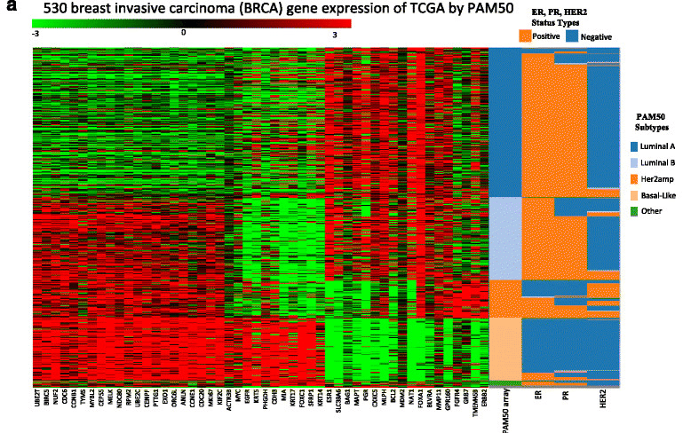
Transcriptomics: Expression-Based Subtypes
PAM50 breast cancer subtype classifications of primary tumors for ER, PR, HER2 status.
Transcriptomics tells us: Expression patterns, active pathways, cell states, tumor heterogeneity
Multi-omics integration can reveal:
Why genes differ (mutations/CNVs driving expression)
Whether mRNA = protein (~50% don't match)
Which targets are functionally active (phosphoproteomics)
Notes:
PAM50 breast cancer subtype classifications of cell lines (panel b) and primary tumors (panel a) for ER, PR, HER2 status. Expression-based classification identifies breast cancer subtypes (Luminal A, Luminal B, HER2-enriched, Basal-like) with distinct biology and clinical behavior, independent of receptor status alone.
Key insight: Expression programs define molecular subtypes with therapeutic relevance. What transcriptomics tells us: active signaling pathways, cell states and heterogeneity, tumor microenvironment composition.
Limitation: RNA abundance ≠ protein abundance ≠ activity. Post-transcriptional regulation and protein stability decouple mRNA from functional output.
Takeaway: Transcriptomics captures gene expression programs but requires integration with proteomics to understand functional consequences.
2016 (This study):
Manual correlation: Pearson correlations between layers calculated separately
Simple scoring: Linear sum (A+B+C+D) to rank cell lines
Predefined features: PAM50 gene set, known pathways
Statistical methods: Clustering, correlation, thresholding
Layer-by-layer: Analyze each omics type independently, then compare
Figure source: Jiang et al., BMC Cancer, 2016 What Gene Expression Tells Us:
1. Molecular subtypes based on transcriptional profiles:
Distinct gene expression "signatures" separate Luminal A, Luminal B, Her2amp, and Basal-like tumors
Clear clustering shows these aren't random groups—they have coherent biology
2. Correlation with clinical markers:
ER/PR/HER2 status (top bars) generally aligns with PAM50 subtypes
But not perfectly—some ER+ tumors cluster with different subtypes, suggesting molecular heterogeneity beyond protein markers
3. Transcriptional programs:
Different gene sets are coordinately upregulated (red) or downregulated (green) across subtypes
Suggests distinct active pathways in each subtype
What's Missing & How Other Omics Help:
Genomics (mutations):
Why are these genes expressed differently?
TP53 mutations common in Basal-like, PIK3CA in Luminal A—genomic drivers shape expression
Copy number alterations (Her2amp = HER2 amplification)
Epigenomics:
Is low expression due to promoter methylation vs mutation vs pathway regulation?
Could reveal therapy targets even without gene mutation
Proteomics:
mRNA ≠ protein always
Post-translational modifications, protein stability affect actual drug targets
Metabolomics/functional assays:
What are the downstream consequences?
Drug sensitivity/resistance may depend on metabolic state not captured by expression
Integration reveals mechanism, not just pattern.

Slide 12
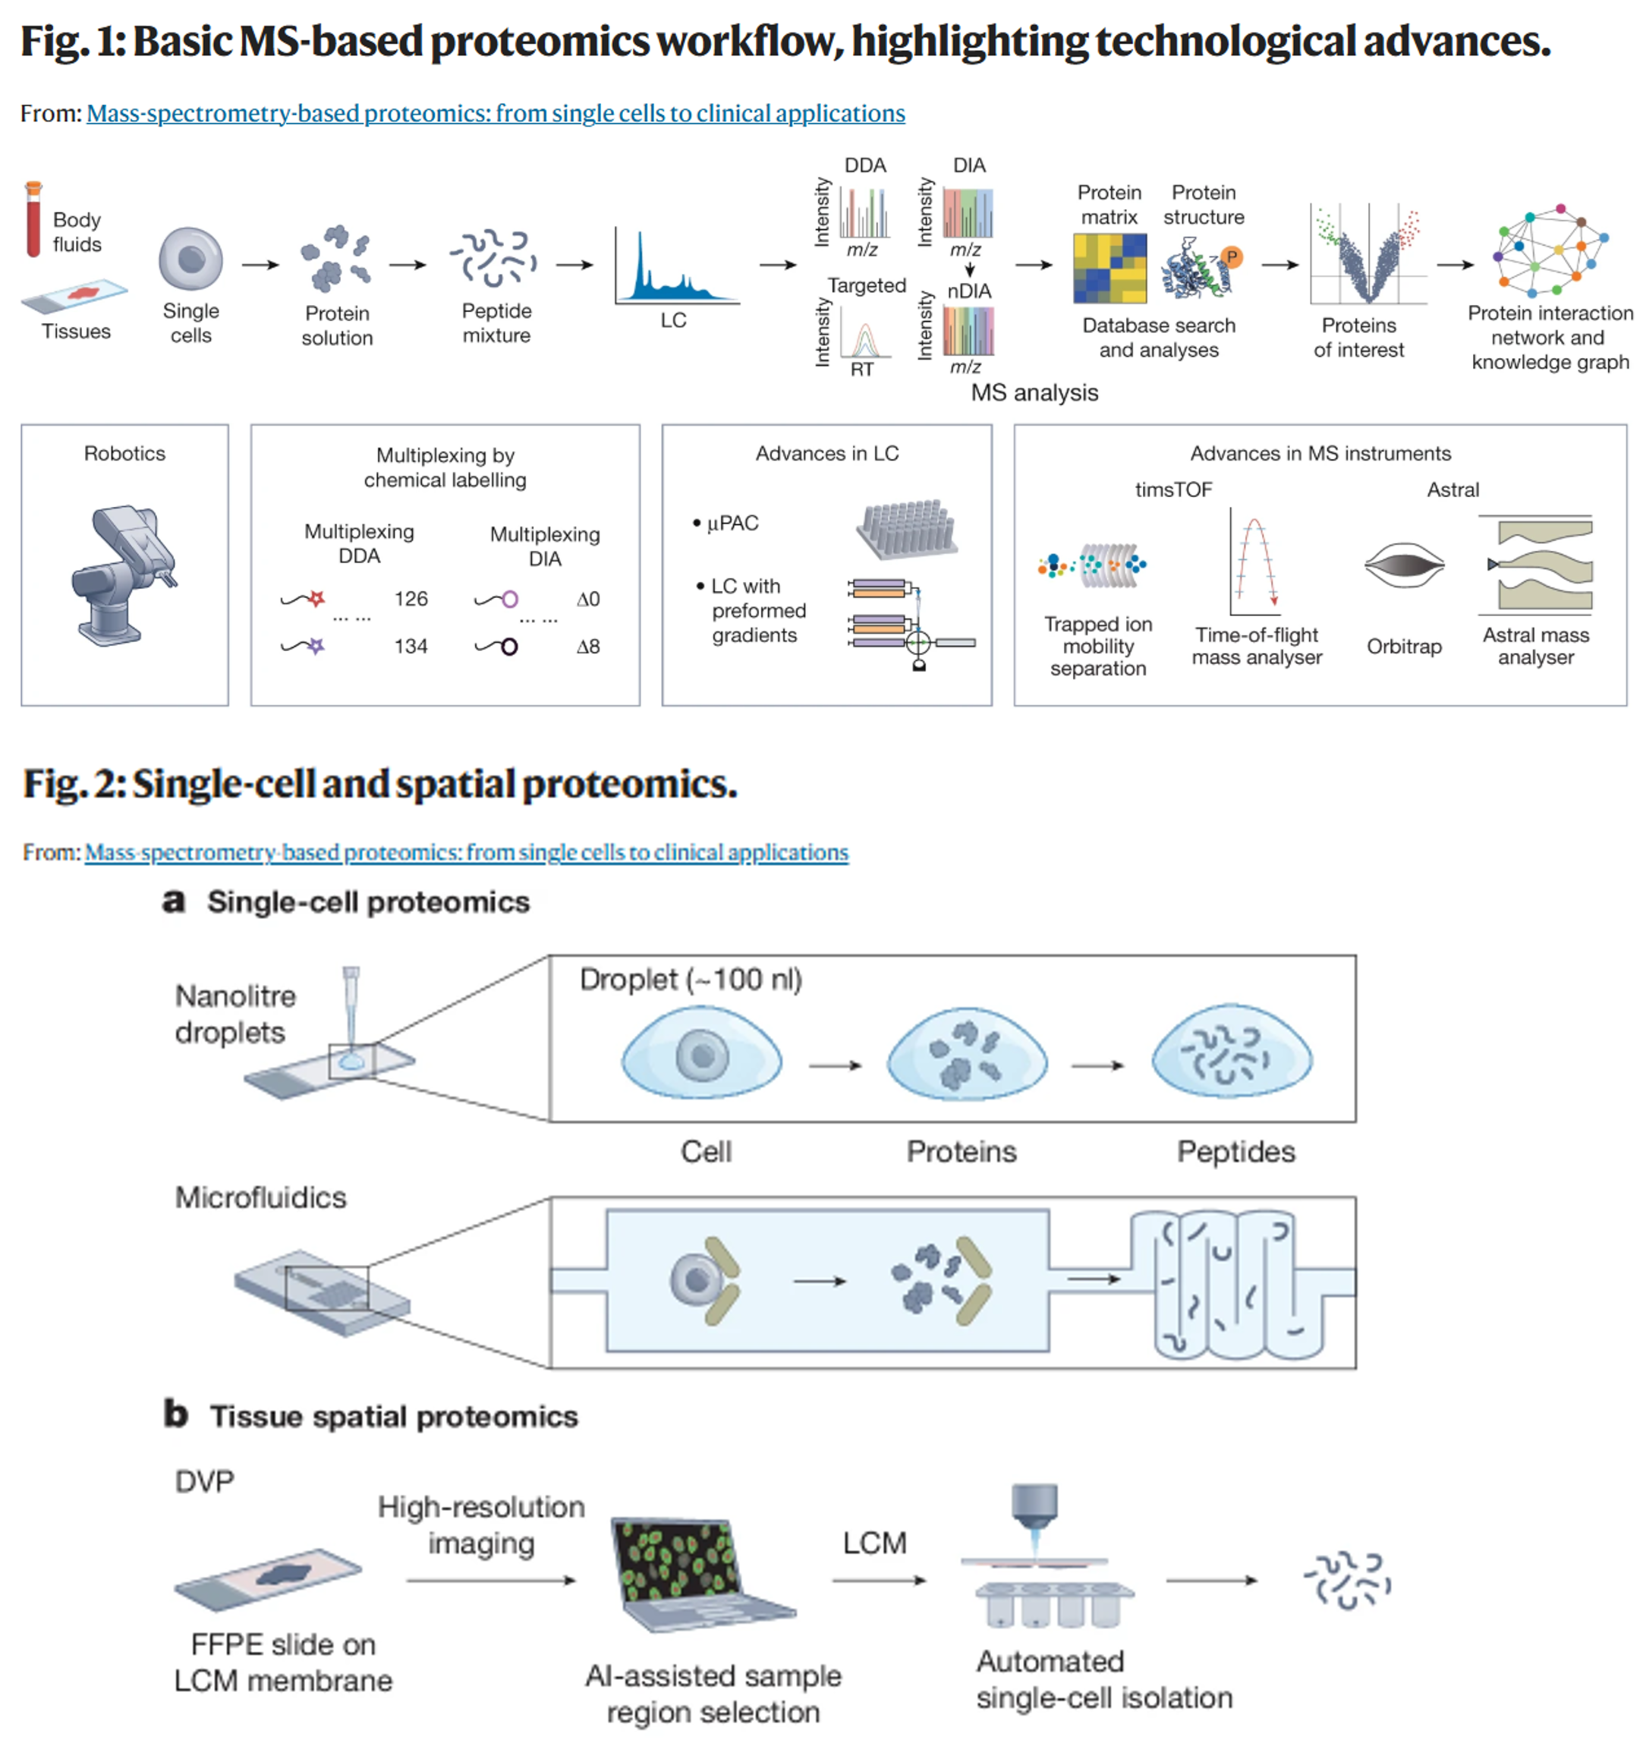
Proteomics: “What makes it happen”
What it measures: Protein abundance, modifications, and interactions
Common technologies:
Mass spectrometry-based proteomics
Antibody-based platforms (RPPA, CyTOF)
Notes:
Proteomics measures the direct effectors of cellular function. Proteins are the functional molecules that carry out biological processes. Basic MS-based proteomics workflow showing sample prep, mass spectrometry analysis, and data processing. Figure also shows single-cell and spatial proteomics capabilities.
Figure source: Bludau & Aebersold, Nat. Rev. Mol. Cell Biol., 2020

Slide 13
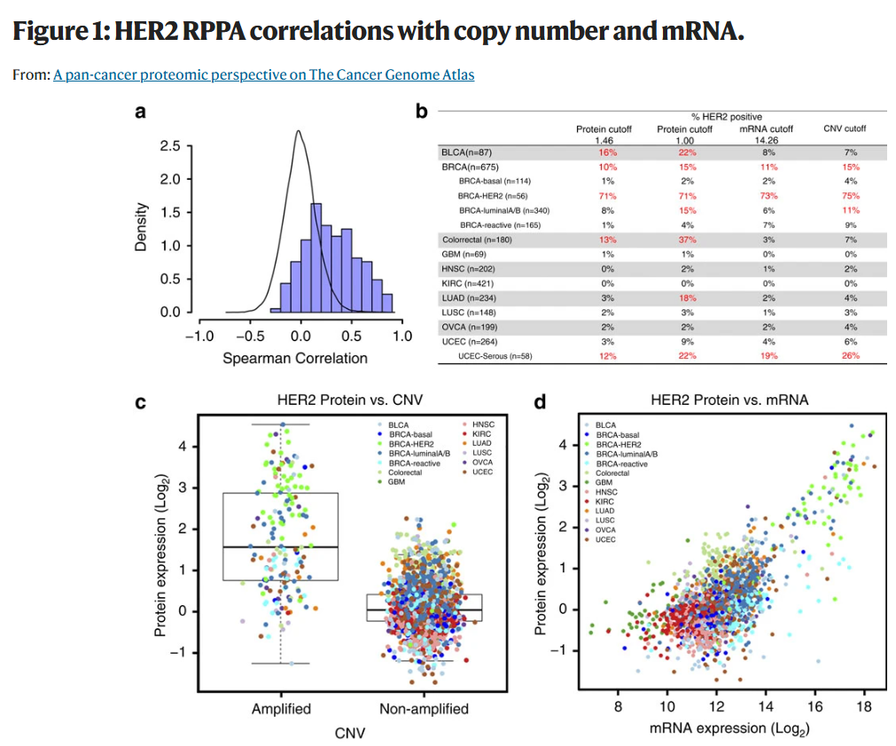
Proteomics: Layer-to-Layer Discordance
HER2 assessment across genomics, transcriptomics, and proteomics in CPTAC pan-cancer analysis.
HER2 classification varies dramatically by layer.
Samples HER2-positive by protein may be negative by RNA or CNV.
Discordance across layers motivates multi-omics integration.
Notes:
HER2 assessment across genomic (copy number), transcriptomic (mRNA), and proteomic (protein) layers in CPTAC pan-cancer analysis.
Panel a: Histogram showing Spearman correlation distribution for 206 protein-mRNA pairs - most show modest correlation.
Panel b: Crosstab showing HER2 classification by CNV, mRNA, and protein across 11 tumor types. Red highlighting shows ≥5% discordance. Breast (BRCA) and endometrial (UCEC) cancers subdivided by HER2 protein levels.
Panel c: HER2 copy number vs protein level - amplified samples have higher protein but substantial variation exists.
Panel d: HER2 mRNA vs protein correlation of only 0.53 across all tumors.
Key insight: HER2 classification varies dramatically by layer. Samples HER2-positive by protein may be negative by RNA or CNV. For anti-HER2 therapy decisions, protein measurement is essential.
Takeaway: Discordance across layers motivates multi-omics integration to capture the full regulatory cascade from DNA → RNA → protein. Post-transcriptional regulation and protein stability create layer-specific biology.
Figure source: Zhang et al., Nature Communications, 2016

Slide 14
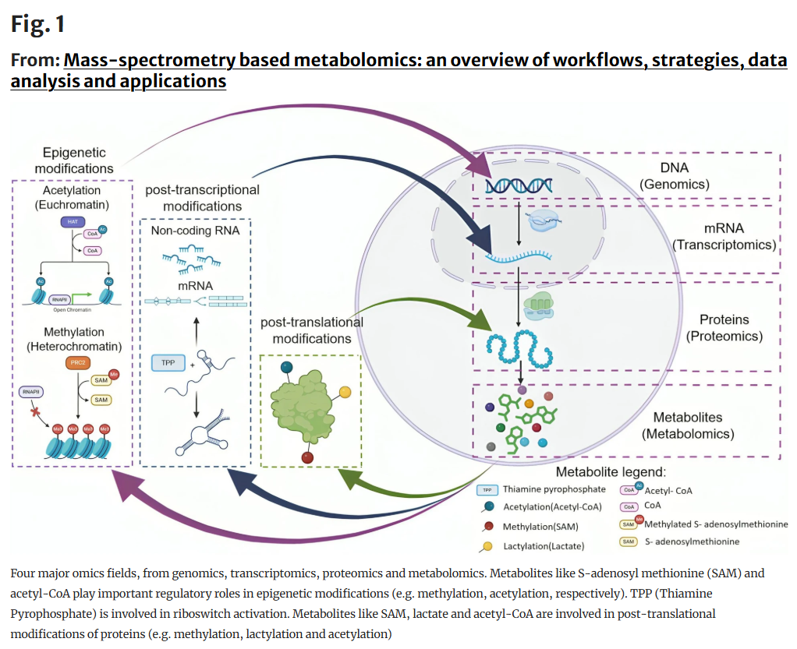
Metabolomics: "What has happened and is happening”
What it measures: Small molecules reflecting metabolic flux and enzymatic activity
What metabolomics tells us:
How metabolic state regulates epigenetics and protein function
Phenotype-proximal biology
Metabolic reprogramming in cancer and immune cells.
Notes:
Metabolomics captures the biochemical endpoint of cellular processes. Metabolites are closest to phenotype in the omics hierarchy. General technical route of metabolomics: sample collection and preparation, metabolite extraction, separation (chromatography), detection (mass spectrometry or NMR), data processing (peak detection, identification, quantification), and statistical analysis.
Metabolites as regulatory molecules connecting omics layers. S-adenosylmethionine (SAM) drives DNA and histone methylation (epigenomics). Acetyl-CoA enables histone acetylation (epigenomics). Thiamine pyrophosphate (TPP) is involved in riboswitch activation (transcriptomics). SAM, lactate, and acetyl-CoA drive post-translational modifications of proteins (proteomics).
Key insight: Metabolites are not just endpoints—they are regulatory signals that directly control gene expression and protein function.
Figure source: Xie et al., Metabolites, 2021

Slide 15
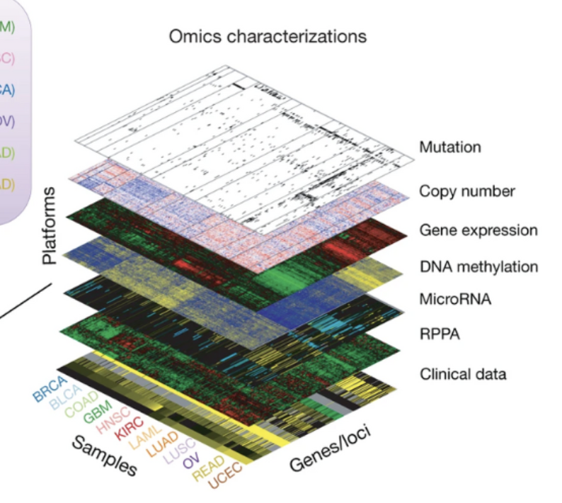
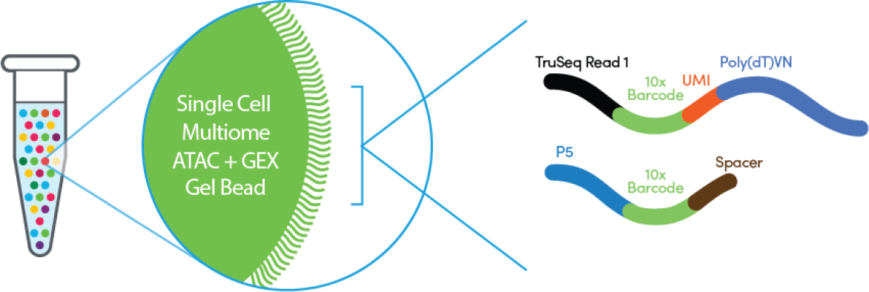
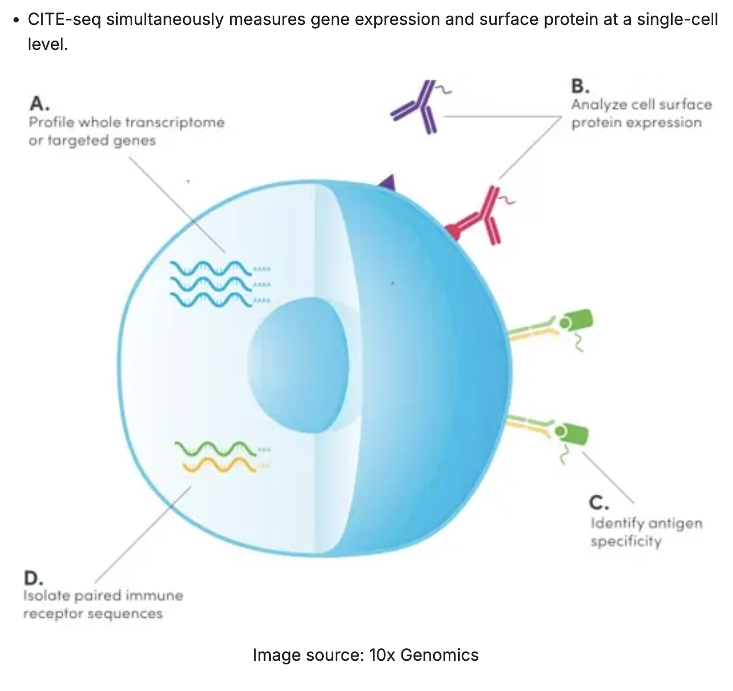
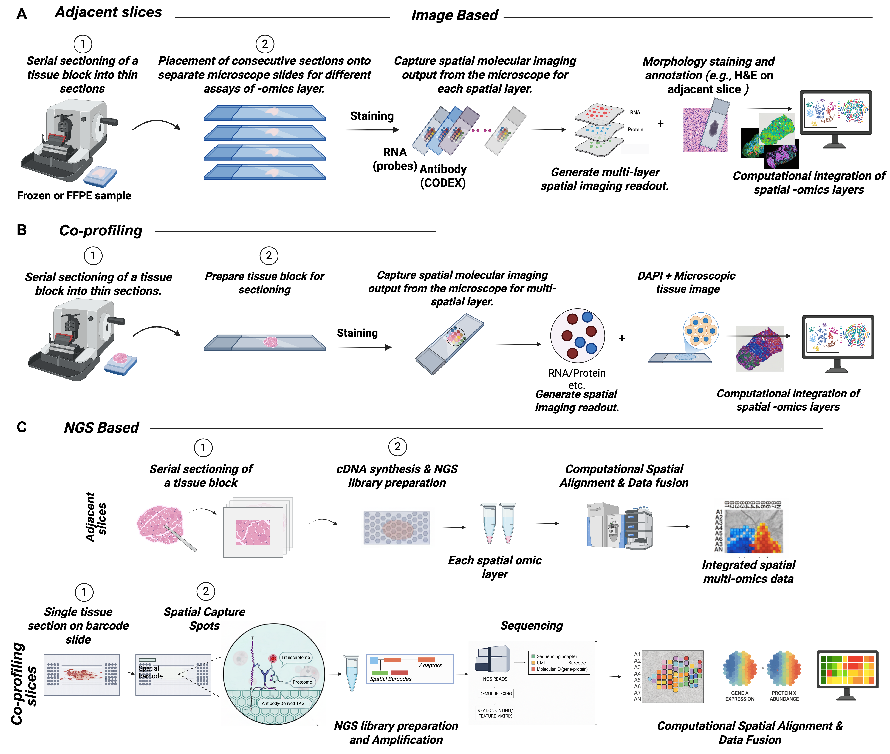
Two Multi-Omics Study Paradigms
Matched inter-modality (parallel)
Joint profiling (multi-modal)
Example: Parallel vs. joint-profiling spatial omics
Notes:
Image Lei 2026 https://ngs101.com/ Left: Parallel multi-omics (matched samples) - Multiple omics measured on the same samples (e.g., tumor aliquots). Enables direct layer-to-layer correlation. Examples: TCGA (WES + RNA-seq + methylation + proteomics), CPTAC (genomics + proteomics), clinical trials with multi-omic profiling.
Right: Joint profiling multi-omics - Multiple omics from the same cells or spatial locations. Requires specialized technologies. Examples: CITE-seq (scRNA + protein), 10X Multiome (scATAC + scRNA), spatial methods (Xenium/CODEX for RNA + protein, PacBio HiFi for DNA + methylation).
Why this distinction matters: Different technologies enable different biological questions and require different integration approaches. Parallel studies can have batch effects between platforms but measure larger sample sizes. Joint profiling eliminates batch effects but is technically more challenging.

Slide 16
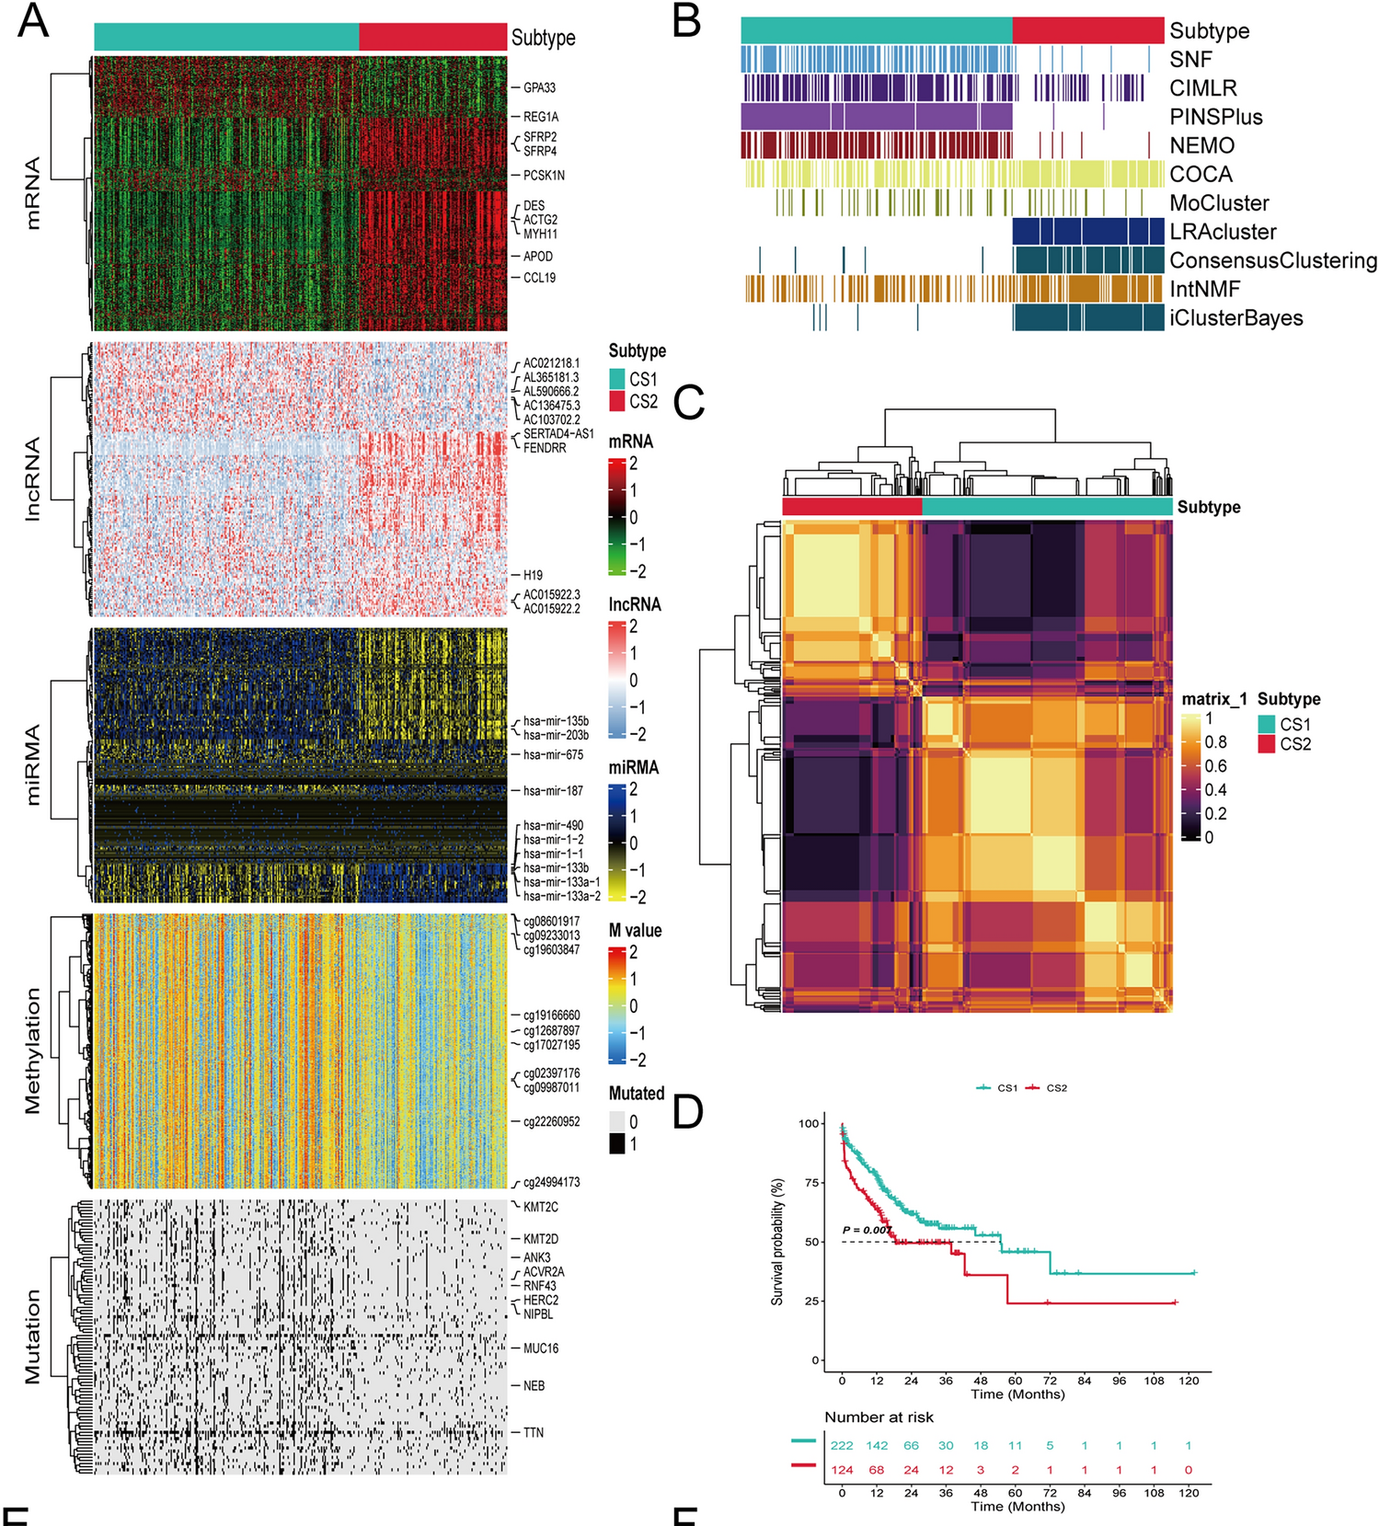
Parallel Multi-Omics Study Example
Integrated multi-omics + machine learning identify prognostic subtypes in gastric cancer
Approach: TCGA cohort with matched transcriptomics (mRNA, lncRNA, miRNA), DNA methylation, and somatic mutations; 10 consensus clustering algorithms identify 2 molecular subtypes with distinct survival
Why multi-omics + ML:
Consensus across methods = robust subtypes (not artifacts)
Integration captures patterns invisible to single omics
Prognostic stratification beyond clinical features alone
Notes:
Fig. 2
From: Multiomics integration and machine learning reveal prognostic programmed cell death signatures in gastric cancer
This study gathered multi-omics data from the gastric cancer cohort (STAD) of The Cancer Genome Atlas (TCGA) (https://portal.gdc.cancer.gov), including patients with comprehensive transcriptomic expression, DNA methylation, and somatic mutation information and applied multiomics approaches, integrating transcriptomic, epigenetic, and somatic mutation data, with consensus clustering algorithms to classify GC molecular subtypes and assess their biological and immunological features. GC integrated multimodal subtype analysis. (A) Extensive heatmap depicting consensus molecular subtypes, integrating mRNA, lncRNA, miRNA, DNA CpG methylation patterns, and gene mutations; (B) Stratification of GC cohorts via 10 diverse multimodal clustering methodologies; (C) Matrix representing consensus clustering of two emerging prognostic subtypes, derived from a synthesis of 10 distinct algorithms; (D) Kaplan–Meier survival plots delineating the prognostic trajectories of the identified subtypes;

Slide 17
Parallel Multi-Omics Databases
Primary Data Resources
TCGA (The Cancer Genome Atlas): 33 cancer types; genomics, RNA-seq, methylation, CNV from same tumor samples
CPTAC proteomics/phosphoproteomics to TCGA samples
ICGC International cancer genomics, matched multi-omics
TARGET: Pediatric cancers with matched multi-omics
BeatAML: Acute myeloid leukemia with matched multi-omics plus drug response
CCLE ~1,000 cancer cell lines with matched genomics/transcriptomics/proteomics
DepMap (Cancer Dependency Map): Builds on CCLE, adds CRISPR screens
GTEx: 54 normal tissues, matched WGS + RNA
Access Portals/Analysis Platforms
GDC Data Portal (Genomic Data Commons): Hosts and provides access to TCGA and TARGET data
cBioPortal: Visualization and analysis platform for TCGA and other cancer studies
UCSC Xena: Integrative multi-omics analysis and visualization browser
LinkedOmics: Multi-omics correlation and pathway analysis tool

Slide 18
Joint Profiling: Single-Cell Multi-Omics
Omics Combination | Technologies
Genome + Transcriptome | G&T-seq, TARGET-seq, sci-L3
Epigenome + Transcriptome | sci-CAR, SNARE-seq, SHARE-seq
Transcriptome + Protein | CITE-seq, REAP-seq, ASAP-seq
Triple Modality | TEA-seq, DOGMA-seq
Advantage: All measurements from the same cells
Eliminates batch effects between modalities
Reveals cell-level regulatory relationships
Spatial multi-omics maintains tissue architecture
Notes:
Joint profiling eliminates batch effects and sample heterogeneity by measuring multiple omics from individual cells. This table shows representative technologies for different omics combinations. The field is rapidly evolving with new methods published regularly. Spatial multi-omics is an emerging area that maintains tissue architecture while measuring multiple modalities.

Slide 19
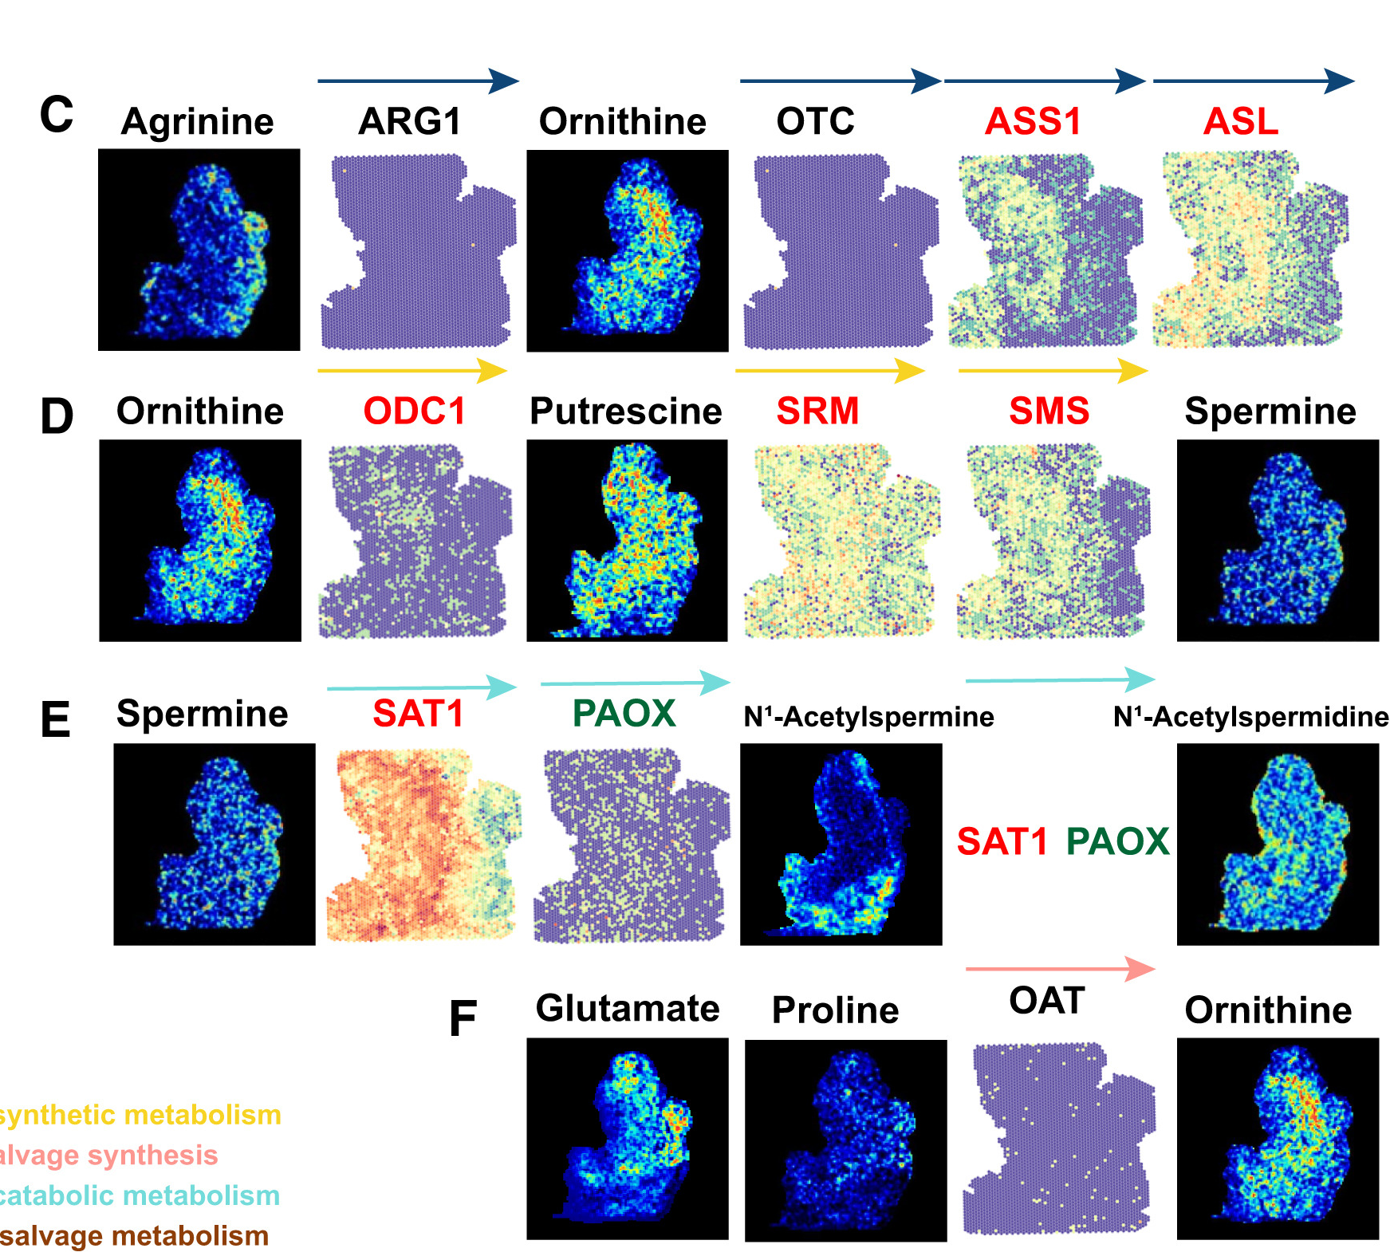
Joint Profiling: Spatial Metabolomics
Integrated spatial omics of metabolic reprogramming in pancreatic cancer.
Study integrated spatial metabolomics with spatial transcriptomics and proteomics to map metabolic rewiring.
Enzyme expression corresponds to metabolite spatial distribution, revealing metabolic compartmentalization and tumor-stroma metabolic crosstalk.
Notes:
Integrated spatial omics of metabolic reprogramming in pancreatic cancer. Study integrated spatial metabolomics with spatial transcriptomics and proteomics to map metabolic rewiring.
Panel A: Spatial maps of metabolites (histidine, glutamine, asparagine, alanine, glycine, serine, proline, cystathionine) showing distinct distributions. UMAP plots and violin plots for key enzymes (GLUL, GLS, ASNSD1, GPT, GOT2, ALDH18A1, PYCR1, PRODH2, PSAT1, PSPH, SHMT2) showing expression in malignant vs normal vs stroma vs immune regions. Color gradients show mass intensity (blue=low, red=high) and gene expression levels.
Panels B-F: Sequential metabolic pathways mapped spatially: - Arginine → ornithine (via ASL, ARG1) → citrulline (via OTC) - Ornithine → putrescine (via ODC1) → spermidine/spermine (via SRM, SMS) - Glutamate → ornithine (via OAT) - Proline → putrescine (via multiple steps) - N1-acetylspermidine formation (via SAT1, PAOX)
Each panel shows spatial maps of metabolites and corresponding enzyme expression (spatial plots + UMAP plots), revealing compartmentalization between tumor, stroma, and immune regions.
Key insight: Serine/glycine metabolism, glutamate-derived pathways, and polyamine synthesis show spatially distinct patterns. Enzyme expression corresponds to metabolite spatial distribution, revealing metabolic compartmentalization and tumor-stroma metabolic crosstalk.
Takeaway: Spatial integration of metabolomics, transcriptomics, and proteomics maps metabolic reprogramming at cellular resolution. This identifies spatially restricted metabolic vulnerabilities for targeted therapy.
Figure source: Karasik et al., Cancer Cell, 2024

Slide 20
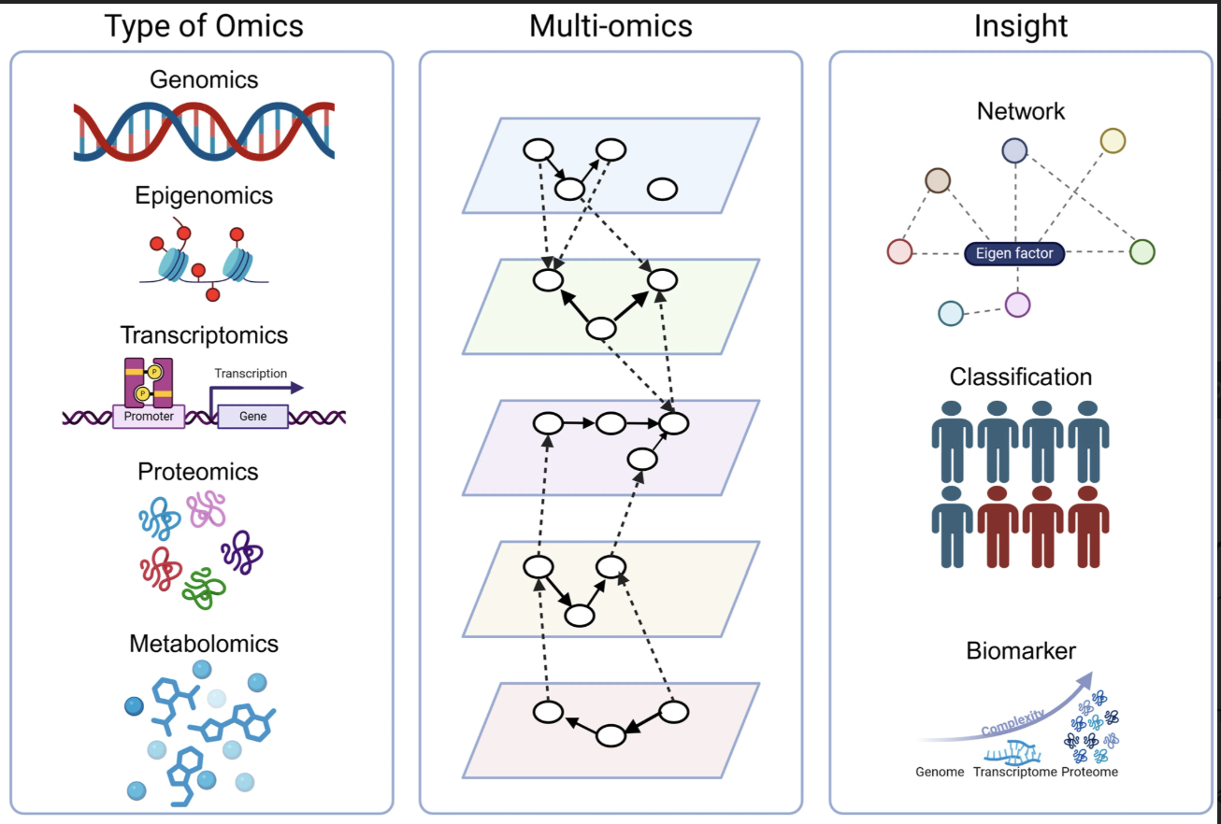
Two Types of Insights From Multi-Omics Analysis
Sample-Focused:
Groups patients into subtypes
Predicts clinical outcomes
Identifies biomarkers
Feature-Focused:
Infers regulatory mechanisms
Builds molecular networks
Reveals causal relationships
Notes:
Left panel: Individual omics types. Middle panel: Multi-omics integration showing within-layer relationships (nodes and edges within each plane) and cross-layer relationships (dashed lines between planes). Right panel: Two types of insights - Network (feature-focused integration connecting molecular features across layers) and Classification (sample-focused integration clustering samples based on multi-omics similarity).

Slide 21
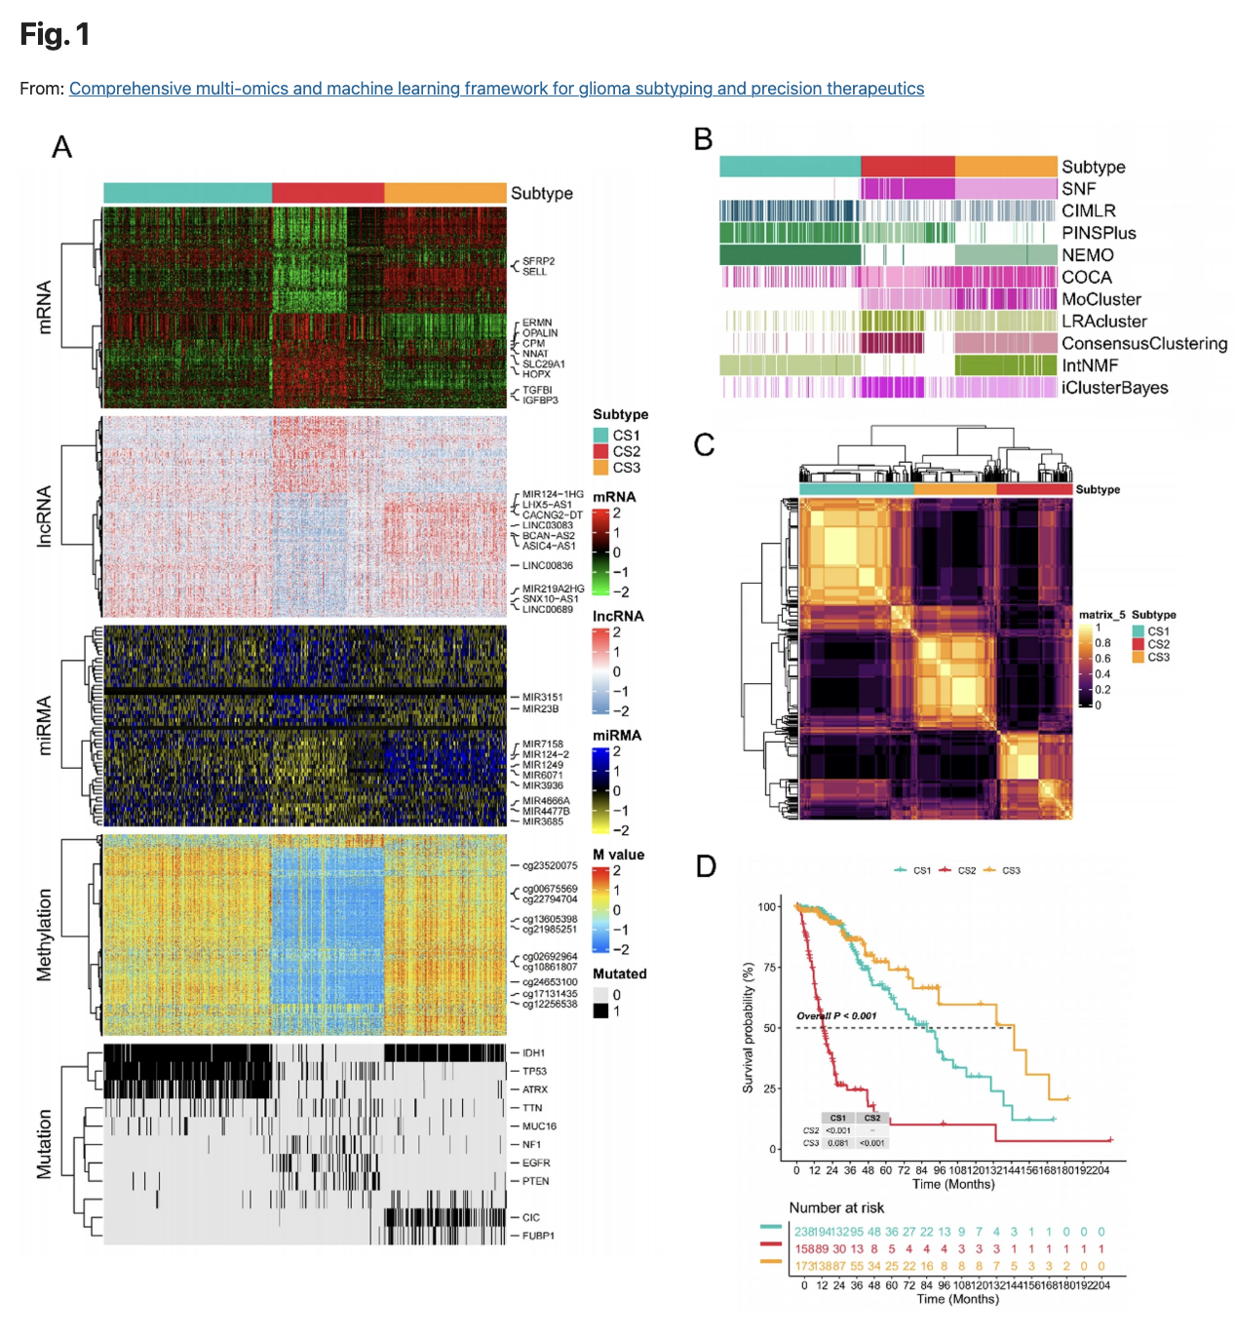
Sample-Focused: Classify Samples (Molecular Subtyping)
Approach: Consensus clustering across omics layers
Key findings:
Three glioma subtypes identified
Distinct molecular signatures
Significant survival differences
Takeaway: Sample integration identifies clinically actionable patient subtypes
Notes:
Multi-omics clustering and survival analysis of glioma patients. Panel A: Integrated clustering using mRNA, lncRNA, miRNA, methylation, mutations. Panel B: Clustering consistency across methods. Panel C: Consensus heatmap showing stability. Panel D: Kaplan-Meier survival curves showing significantly different outcomes between subtypes. https://www.nature.com/articles/s41598-025-09742-0/figures/1

Slide 22
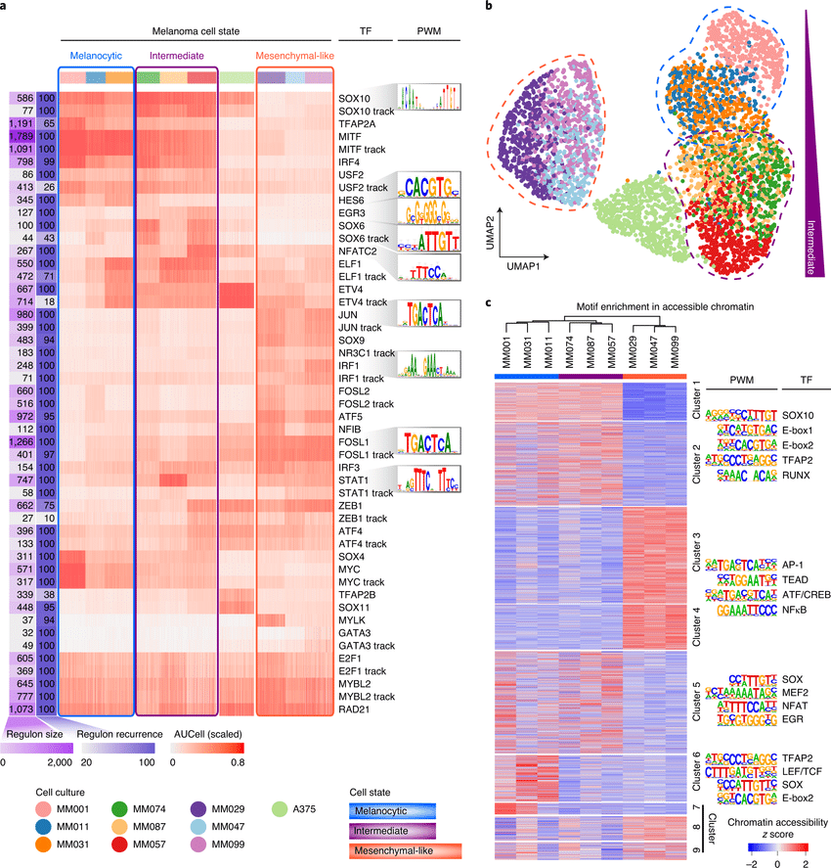
Feature-Focused: Identify Regulatory Networks
Approach: SCENIC integrates scRNA-seq with TF motifs and ATAC-seq
Key findings:
TF programs define cell states
Chromatin accessibility validates predictions
Reveals melanoma phenotype switching mechanisms
Takeaway: Feature integration identifies regulatory logic across layers
Notes:
Panel a: Regulon activity heatmap showing TF programs distinguishing melanocytic, intermediate, mesenchymal states with DNA-binding motifs. Panel b: UMAP based on regulons separates intermediate state—regulatory programs define cell identity. Panel c: ATAC-seq validates predicted TF binding sites are accessible in corresponding states. This reveals the regulatory logic connecting epigenomics to transcriptomics.
Figure source: Wouters et al., Cell Reports, 2020

Slide 23





Meta-Analysis: Independent Omics Pipelines
Each omics layer is analyzed separately, then results are compared post hoc
1
Analyze Each Omics Layer
2
Generate Hit Lists
3
Intersect Results
RNA-seq → DESeq2 / edgeR
Differential gene expression
Each pipeline produces an independent
list of significant features:
Downregulated genes (padj < 0.05)
Hypermethylated promoters (Δβ > 0.2)
Depleted proteins (log2FC < -1)
Thresholds are applied independently
for each data type.
RNA
Meth
Methylation → limma / DMRcate
Differential CpG analysis
Proteomics → MaxQuant / Perseus
Differential protein abundance
Convergent hits found by overlap
(e.g. silenced + hypermethylated genes)
Example: TCGA breast cancer studies
identified candidate tumor suppressors
via Venn-diagram intersection of
DE genes and DM promoters.
Source: TCGA Consortium (Nature 2012) — Breast, Colorectal, GBM landmark studies
Notes:
So before we talk about integrative approaches, let's look at how multiomics was traditionally handled — and honestly, how it's still done in many studies today.
The idea is straightforward. You take each omics layer and run it through its own well-established pipeline. RNA-seq goes through DESeq2, methylation data goes through limma or DMRcate, proteomics through MaxQuant — whatever the gold standard is for that data type. Each pipeline produces its own list of significant hits using its own statistical thresholds.
Then, at the very end, you compare those lists. You take your downregulated genes and your hypermethylated promoters and you ask: where do they overlap? That intersection — genes that are both silenced and hypermethylated — gives you your candidate tumor suppressors, for example. This is exactly what the early TCGA studies did for breast and colorectal cancer. It works, it's intuitive, and it's easy to interpret. But it has some real limitations.

Slide 24


Challenges of Independent Analysis
Why the overlap approach leaves biological signal on the table
Loss of Sub-Threshold Signal
No Cross-Layer Interactions
Features must pass significance thresholds independently in each layer. A gene with modest expression change (p = 0.08) and modest methylation change (p = 0.06) is discarded — even if the joint signal is strong. This systematically misses coordinated, moderate-effect biology.
Independent pipelines cannot model how one omics layer mechanistically influences another. A phosphorylation event triggering downstream transcription is invisible when phosphoproteomics and RNA-seq are analyzed in isolation with separate statistical models.
Heterogeneous Feature Spaces
Inflation of False Negatives
Each omics has different dimensionality (20K genes vs 500K peaks vs 5K metabolites), data distributions (counts vs intensities vs beta values), and sparsity (10–45% non-zero in scRNA-seq vs 1–10% in scATAC-seq). Venn overlaps ignore these fundamental asymmetries.
Intersection-based approaches are overly conservative. If each layer independently has 80% power, the intersection has only ~64% power to detect a true cross-omics signal. The more layers intersected, the worse this compounds.
Chen et al. Genome Biology 2019 · Barros et al. Briefings in Bioinformatics 2025 · Gómez-de-Mariscal et al. Frontiers in Genetics 2024
Notes:
So what's the problem with this overlap approach? There are four key issues.
First, you lose sub-threshold signal. If a gene has a modest expression change at p equals 0.08 and a modest methylation change at p equals 0.06, it fails both filters independently — even though the coordinated signal across both layers might be highly significant. You're systematically discarding moderate-effect biology.
Second, you can't model cross-layer interactions. A phosphorylation event driving a transcriptional change is invisible when those two data types are analyzed in completely separate pipelines.
Third, the feature spaces are fundamentally different — 20,000 genes versus half a million ATAC peaks versus a few thousand metabolites, all with different distributions and sparsity levels. A Venn diagram doesn't account for any of that.
And fourth, this compounds statistically. If each layer has 80% power, intersecting them gives you roughly 64% power. The more layers you add, the worse it gets. So we need approaches that model these layers jointly.

Slide 25





Integrative Solutions: Multi-Modal Approaches
Joint modeling captures cross-layer interactions that overlap approaches miss
Latent Factor Models
Regulatory Network Inference
Deep Learning Fusion
Joint dimensionality reduction
Knowledge-guided causal models
Attention-based cross-modal learning
MOFA2 · iCluster+ · DIABLO
COSMOS · SCENIC+ · LINGER
CrossAttOmics · MultiGATE · scGLUE
Decompose multiple omics into shared latent factors that capture coordinated variation across layers. Recover signals too weak to survive independent thresholding by borrowing statistical strength across modalities.
Integrate prior knowledge (TF motifs, signaling pathways, metabolic maps) with multiomics measurements to infer directed regulatory relationships. Model how changes propagate from epigenome → transcriptome → proteome → metabolome.
Use cross-attention mechanisms and graph neural networks to learn nonlinear dependencies between heterogeneous omics features. Handle mismatched dimensionalities, batch effects, and both paired and unpaired experimental designs.
Detects coordinated moderate effects
Models cross-layer causal mechanisms
Handles heterogeneity natively
Key advantage: Integrative methods recover biology invisible to overlap-based approaches by jointly modeling cross-layer dependencies.
Notes:
So how do we do better? There are three main families of integrative methods, and they each solve the problem differently.
The first is latent factor models — tools like MOFA2, iCluster+, and DIABLO. These decompose all your omics layers simultaneously into shared latent factors. The key advantage is that they borrow statistical strength across modalities, so they can recover coordinated signals that are too weak to survive independent thresholding.
The second family is regulatory network inference — COSMOS, SCENIC+, LINGER. These are knowledge-guided. They incorporate prior information about TF binding motifs, signaling cascades, and metabolic pathways to build directed, causal models of how changes propagate from epigenome to transcriptome to proteome.
And the third is deep learning fusion — CrossAttOmics, MultiGATE, scGLUE. These use attention mechanisms and graph neural networks to handle the heterogeneity problem natively: mismatched dimensions, different data types, batch effects, paired or unpaired designs.
The unifying theme is that all of these recover biology that is simply invisible to the overlap approach.

Slide 26

Heterogeneity Across Omics Platforms
Each data type differs in scale, distribution, dimensionality, and temporal resolution
Omics Layer | Data Type | Features | Sparsity (single-cell) | Temporal Window | Platform Bias
RNA-seq | Discrete counts (UMIs) | ~20,000 genes | 55–90% dropout | Minutes–hours (mRNA half-life) | GC-content bias PCR amplification
scATAC-seq | Binary / sparse counts | 100K–500K peaks | 90–99% dropout | Hours–days (chromatin state) | Tn5 insertion bias Low copy number
Proteomics (MS-based) | Continuous intensity | 5,000–10,000 proteins | N/A (bulk typical) | Hours–days (protein half-life) | Ionization suppression
Methylation (450K/EPIC) | Beta values (0–1 bounded) | 450K–850K CpG sites | N/A (array-based) | Days–weeks (epigenetic memory) | Probe cross- hybridization
Metabolomics (untargeted) | Continuous intensity | 1,000–5,000 m/z features | N/A (bulk typical) | Seconds–minutes (metabolite flux) | Matrix effects Ion suppression
Key insight: These are not minor differences — they are fundamentally different measurement modalities with incompatible statistical assumptions.
Notes:
Let me walk you through why you can't just throw these data types into the same model naively. This table makes it concrete.
Look at the data types first. RNA-seq gives you discrete UMI counts. Proteomics gives you continuous intensity values. Methylation arrays give you beta values bounded between zero and one. These have fundamentally different statistical distributions — you can't apply the same normalization or the same test to all of them.
Now look at dimensionality. RNA-seq measures around 20,000 genes. scATAC-seq can have half a million peaks. Methylation arrays, up to 850,000 CpG sites. Metabolomics might give you a few thousand features. These are wildly different feature spaces, and there's no guaranteed one-to-one mapping between them.
Sparsity is probably the most dramatic difference. In scRNA-seq, you detect maybe 10 to 45 percent of genes per cell. In scATAC-seq, it's 1 to 10 percent — because you're profiling diploid DNA, not thousands of RNA copies. And then the temporal windows are different too: metabolomics captures events on a timescale of seconds, while epigenetic marks persist for days or weeks. Even when you profile the "same" sample, each layer is effectively looking at a different moment in time.

Slide 27




Missing Data in Multiomics
Missingness occurs at every level — features, samples, and entire modalities
Feature-Level Dropout
Sample-Level Missingness
Modality-Level Absence
Within a single omics layer
Across omics layers
Entire omics layers missing
scRNA-seq
Unmatched cohorts
Cost constraints
10–45% of genes detected per cell; the rest are zeros from technical dropout or true absence
RNA-seq profiled on 500 patients, proteomics on only 200 — overlapping set may be just 120
A study may have WGS + RNA-seq but cannot afford phosphoproteomics or spatial transcriptomics
scATAC-seq
Paired vs. unpaired
Tissue limitations
Only 1–10% of accessible peaks detected per cell due to diploid DNA copy number
10x Multiome gives matched RNA + ATAC per cell; most studies have separate profiling batches
FFPE samples support DNA/methylation but yield degraded RNA and poor chromatin accessibility
Impact
Impact
Impact
Gene-gene correlations become unreliable; clustering struggles to find true neighborhoods
Diagonal integration needed; power drops; per-cell cross-modal inference blocked
Regulatory layers invisible; causal chain from mutation → phenotype is incomplete
Chen et al. Genome Biology 2019
Li et al. Nature Communications 2021
Heumos et al. Mol Sys Biol 2025
Argelaguet et al. Nat Methods 2021
Barros et al. Brief Bioinform 2025
Mohr et al. Biomedicines 2024
Notes:
So in addition to heterogeneity, we have to deal with pervasive missing data — and it happens at three distinct levels.
First, feature-level dropout. This is the one most people think of. In scRNA-seq, 55 to 90 percent of your count matrix is zeros. In scATAC-seq, it's even worse — 90 to 99 percent — because DNA is only present in two copies per cell. This isn't just inconvenient; it means gene-gene correlations become unreliable, and clustering algorithms can't find true cell neighborhoods.
Second, sample-level missingness across omics layers. This is extremely common in real studies. You might have RNA-seq on 500 patients but proteomics on only 200, with an overlap of maybe 120. Or you have technologies like 10x Multiome that give you matched RNA and ATAC per cell, but the majority of published datasets were profiled separately. When samples aren't matched, you need specialized diagonal integration methods, and you lose the ability to make per-cell cross-modal inferences.
Third — and this is the one people often overlook — entire modalities can be absent. Budget constraints mean a study might have whole-genome sequencing and RNA-seq but simply cannot afford phosphoproteomics or spatial transcriptomics. Tissue limitations matter too: FFPE samples support DNA and methylation analysis, but yield degraded RNA and poor chromatin accessibility. When an entire regulatory layer is missing, your causal chain from mutation to phenotype has a gap you can't fill.

Slide 28

Computational Strategies for Heterogeneity & Missingness
How modern tools address the fundamental data incompatibilities
Handling Heterogeneity
Handling Missing Data
Modality-Specific Encoders
Imputation & Denoising
Process each omics through its own encoder (VAE, GNN) that respects the data's native distribution before projecting into a shared latent space.
Recover dropped-out features using neighbor smoothing (MAGIC), model-based inference (SAVER, scOpen), or deep autoencoders (DCA) tailored to each data type's noise model.
scGLUE · MultiVI · scECDA
MAGIC · scOpen · SAVER · DCA
Adversarial Alignment
Diagonal / Mosaic Integration
Use discriminator networks to force embeddings from different modalities into a domain-invariant space, correcting for batch and platform effects.
Align unpaired samples across modalities using shared features, anchor-based transfer, or optimal transport to impute missing modalities per sample.
sciCAN · GLUE · totalVI
Seurat v5 Bridge · UINMF · StabMap
Knowledge-Guided Graphs
Probabilistic Frameworks
Encode known regulatory relationships (TF → target gene, peak → gene) as graph edges to bridge heterogeneous feature spaces with biological priors.
Model missingness explicitly with probabilistic generative models that infer latent factors even when entire omics layers are absent for subsets of samples.
SCENIC+ · LINGER · MultiGATE
MOFA2 · MultiVI · MCIA
The best modern frameworks combine multiple strategies — e.g., MOFA2 handles missing modalities while scGLUE handles heterogeneous feature spaces in a single workflow.
Notes:
So how does the field deal with all of this? The solutions split naturally into two categories: handling heterogeneity on the left, and handling missing data on the right.
For heterogeneity, three main strategies have emerged. First, modality-specific encoders — tools like scGLUE and MultiVI process each omics through its own encoder that respects the data's native distribution before projecting everything into a shared latent space. Second, adversarial alignment, where discriminator networks force embeddings from different modalities into a domain-invariant space, explicitly correcting for batch and platform effects. And third, knowledge-guided graphs — SCENIC+, LINGER, and MultiGATE encode known regulatory relationships as graph edges to bridge those heterogeneous feature spaces using biological priors rather than purely statistical alignment.
For missing data, we also have three tiers. Feature-level dropout is addressed with imputation tools like MAGIC and scOpen, which use neighbor smoothing or model-based inference tailored to each data type's noise model. Sample-level missingness is handled by diagonal or mosaic integration methods — Seurat v5's bridge integration, UINMF, and StabMap can align unpaired samples across modalities using shared features or optimal transport. And for whole-modality absence, probabilistic frameworks like MOFA2 can infer latent factors even when entire omics layers are missing for subsets of samples.
The important takeaway is that the best modern frameworks often combine multiple strategies — MOFA2 handles missing modalities while scGLUE handles heterogeneous features, and you can chain them in a single analysis workflow.

Slide 29
Integrative vs Meta-Analysis
Meta-analysis:
Analyze each layer independently
Combine results post-analysis
Example: pathway enrichment overlap
Integrative analysis:
Joint statistical modeling across layers
Leverages cross-layer structure
Example: latent factor models
Notes:
Meta-analysis answers: “Do genomic and transcriptomic analyses independently support this pathway?” Integrative analysis answers: “Which latent factors or regulatory networks explain coordinated variation across layers?”
Why this matters: Integration can reveal cross-layer relationships invisible to separate analyses, but requires stronger assumptions and careful interpretation. Different methods suit different biological questions. Integration is not just stacking plots.

Slide 30
Key Challenges in Multi-Omics
Discordance across layers is often biological signal, not noise
Missing data differs by platform and layer
Batch effects vary across technologies
Interpretability vs model complexity tradeoffs
Notes:
These challenges will be central themes in upcoming speaker presentations. Each investigator addresses these issues differently based on their biological question and available data. Understanding these challenges prepares you to critically evaluate multi-omics methods and results.

Slide 31
Challenge: Layer-to-Layer Discordance
Common observations:
RNA–protein correlation often modest (ρ ~ 0.4–0.6)
Open chromatin without expression
Metabolic changes without transcriptional shifts
Disagreement across layers often reveals post-transcriptional regulation, protein stability, and metabolic control.
Notes:
Example: HER2 protein positivity without RNA overexpression indicates post-transcriptional or protein stability mechanisms, creating distinct therapeutic vulnerabilities. Integration methods must distinguish biological discordance from technical noise. This is a feature, not a bug—the discordance tells us about regulatory mechanisms.

Slide 32
Challenge: Missing Data
Types:
Missing by design (not all samples on all platforms)
Missing not at random (low-abundance dropout)
Platform-specific (scRNA-seq zeros, proteomics detection limits)
Impact: Breaks naïve integration, requires careful modeling
Notes:
Missing data is fundamental in multi-omics. Cost and sample limitations mean not all samples are profiled on all platforms. Low-abundance molecules drop out in a biology-dependent manner. Single-cell RNA-seq has high zero rates. Proteomics misses low-abundance proteins.
Why this matters: Breaks correlation-based integration approaches. Requires careful imputation or missingness-aware models. Limits interpretation—is a feature absent or undetected? Upcoming speakers will discuss how they address missingness in their workflows.

Slide 33
Preparing for Upcoming Sessions
What we’ve established:
Each omics layer provides a distinct biological view
Study design (parallel vs joint) shapes questions and methods
Analysis paradigm (sample vs feature-focused) serves different goals
Challenges are inherent to multi-omics biology
Looking ahead:
UF and external researchers will present methods addressing these challenges in cancer, immunology, and spatial biology contexts.
Notes:
Questions to carry forward: How do we distinguish biological signal from technical noise across layers? When should we integrate vs analyze separately? How do we make multi-omics findings actionable in clinical settings? These questions will frame your engagement with upcoming speakers as they present their research approaches and findings.

Slide 34
Questions and Discussion
What questions do you have about multi-omics concepts, study designs, or analytical approaches?
What multi-omics applications are most relevant to your research?

